Slide 1
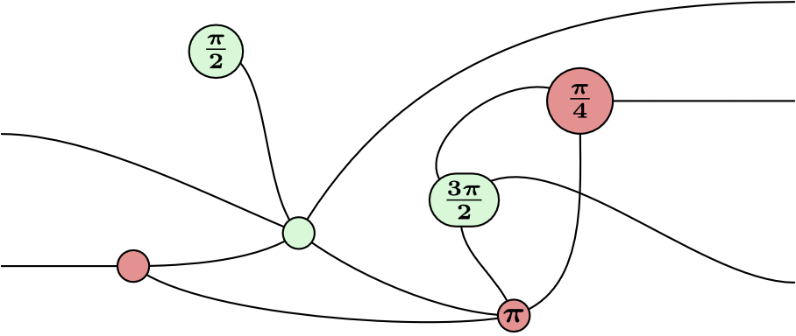
ZX-Calculus
Manuel Lerchner
25.05.2023

Slide 2
What is ZX-Calculus?
A way to represent Quantum Circuits
Graphical language
Rules for simplifying the Diagram

Slide 3
Applications
Quantum Circuit Optimization
T-Count Optimization
Circuit Compilation

Slide 4
Quantum Circuit Optimization
Idea: Transform circuits into equivalent circuits:
Goal: Fewer or simpler Gates
But why use ZX-Calculus for this?

Slide 5
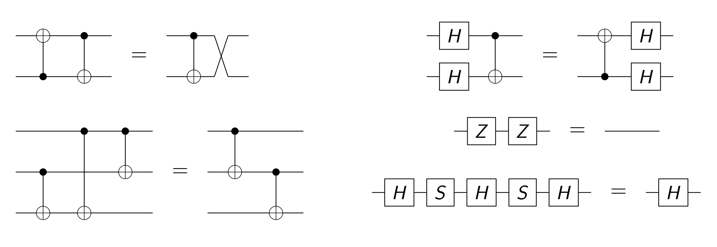
Classical Optimization
Fig. 2: Circuit Identities

Slide 6
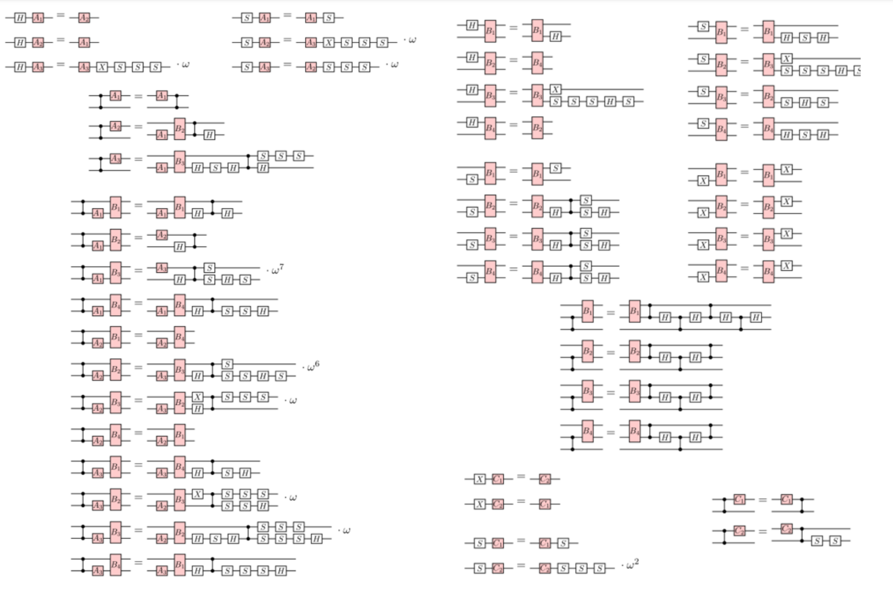
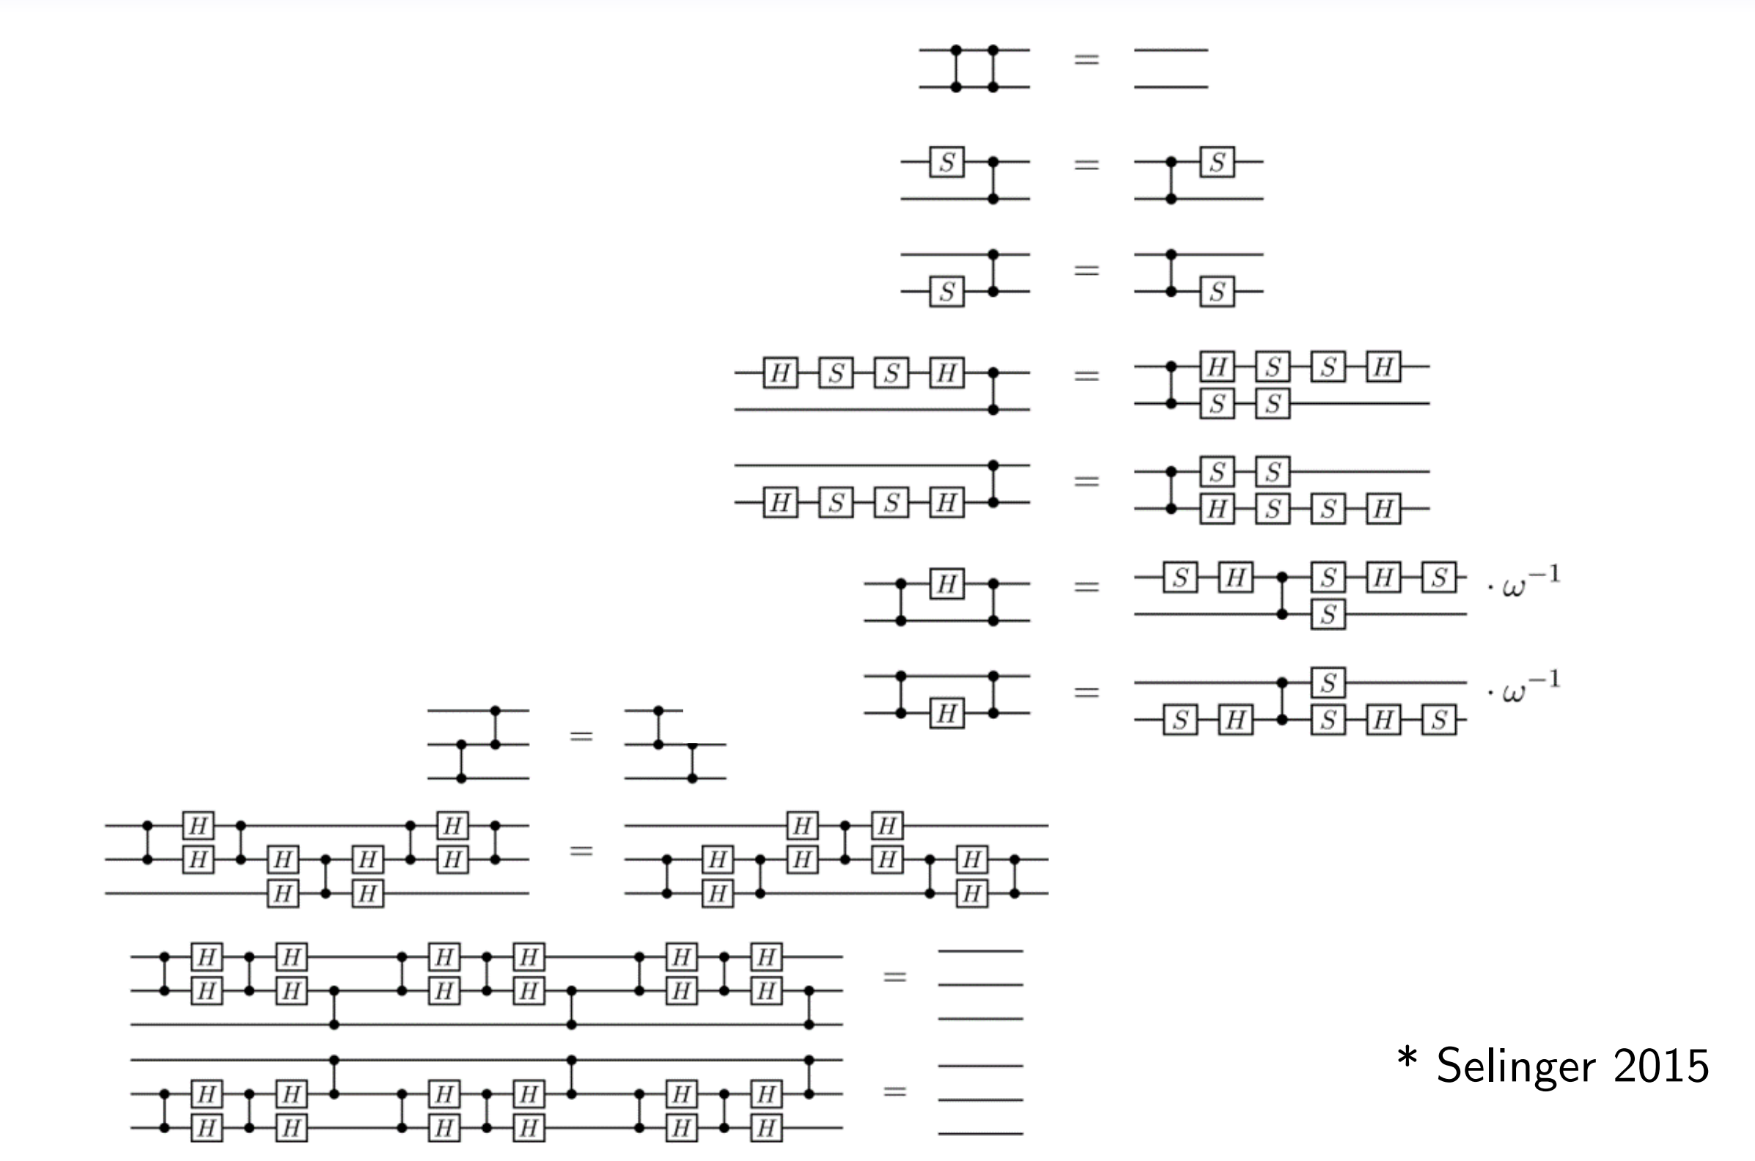
Classical Optimization
Fig. 2: Circuit Identities

Slide 7
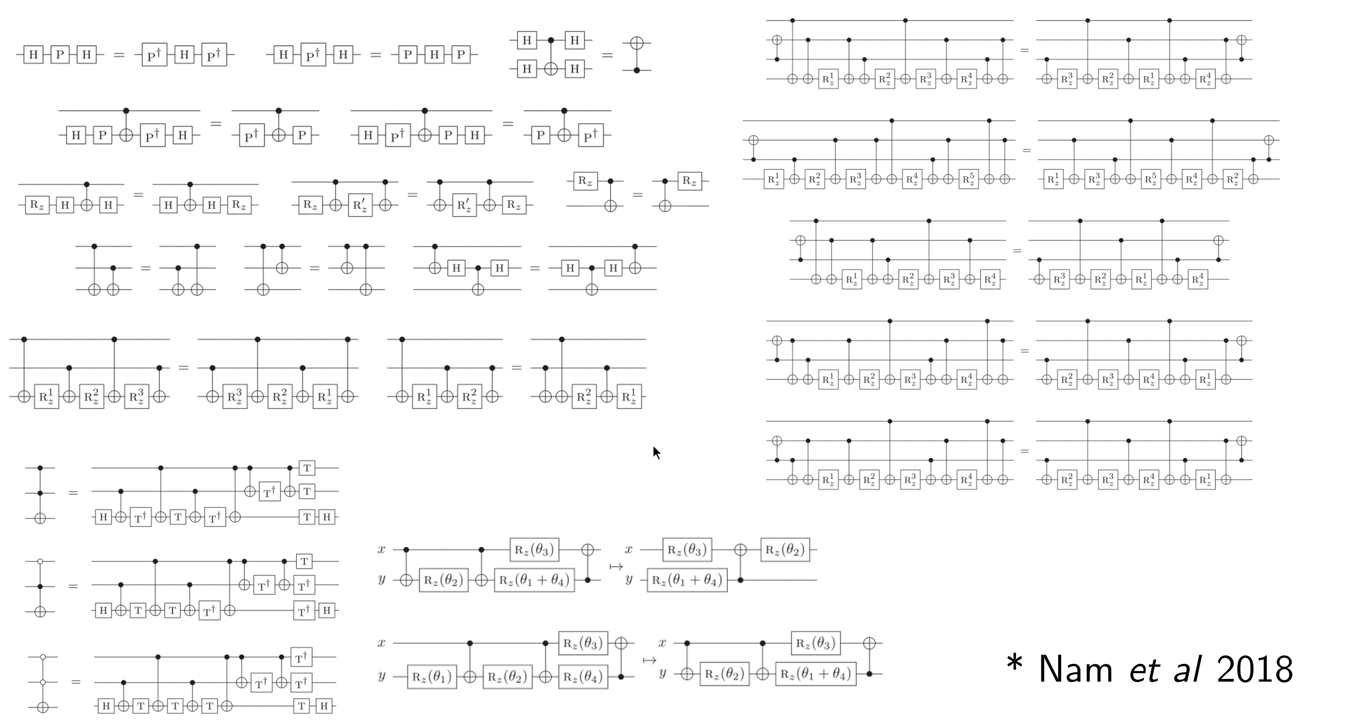
Classical Optimization
Fig. 2: Circuit Identities

Slide 8
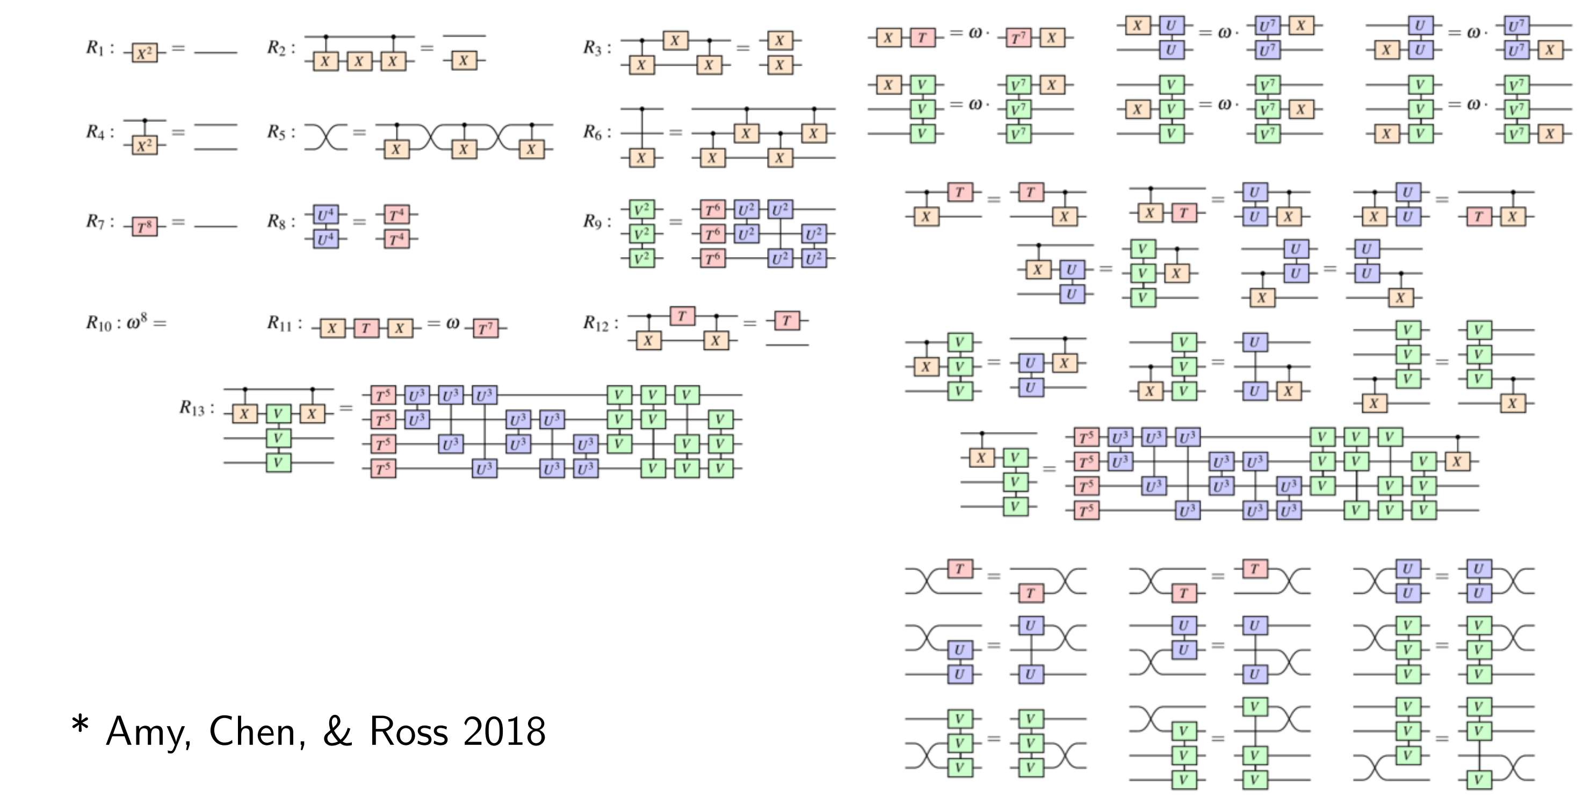
Classical Optimization
Fig. 2: Circuit Identities

Slide 9
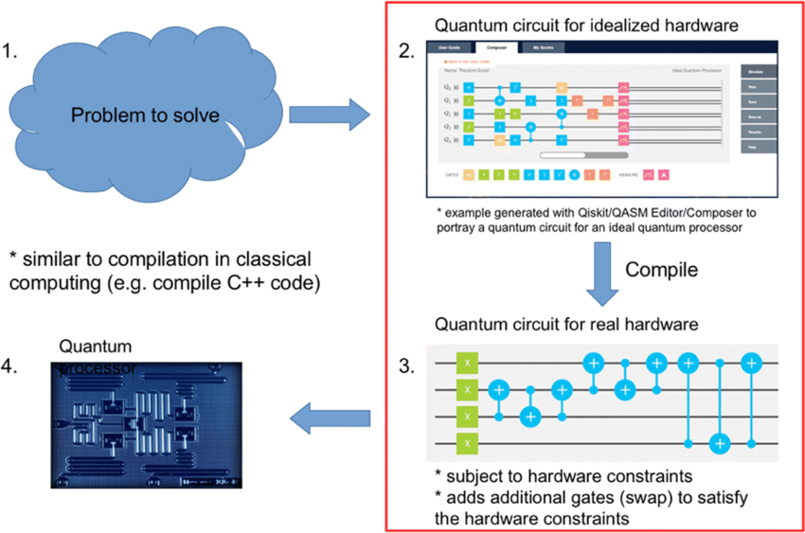
Compilation of quantum circuits
Circuits use many abstract gates
Problems of real quantum computers:
Limited set of gates
Limited connectivity between qubits
Fig. 3: Quantum Compilation

Slide 10
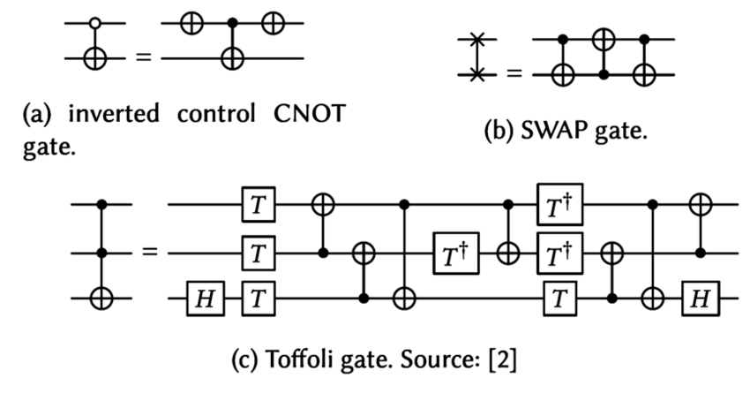
T-Count Optimization
Quantum computers are affected by noise
Clifford+T Circuits can be made tolerant to noise
Idea: Introduce Error Correcting Codes
Problem: Many new T-Gates need to be introduced
Difficult to simulate (Hardware Limits)
ZX-Calculus can simplify such circuits
Fig. 4: Fault tolerant Toffoli Gate

Slide 11
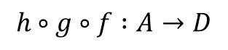
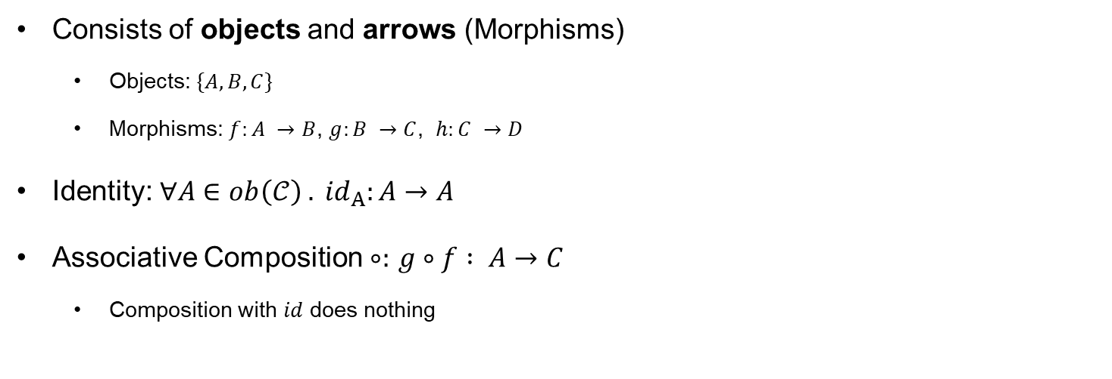
Mathematical Background: Category Theory
Consists of objects and arrows (Morphisms)
Objects: $\{A,B,C\}$
Morphisms: $f:A →B$, $g:B →C$, $h:C →D$
Identity: ${∀A∈ob\left(𝒞\right) . id}_{A}:A→A$
Associative Composition $∘:$ $g∘f : A→C$
Composition with $id$ does nothing
IMG SEQ
$$h∘g∘f :A→D$$

Slide 12
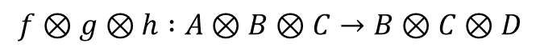
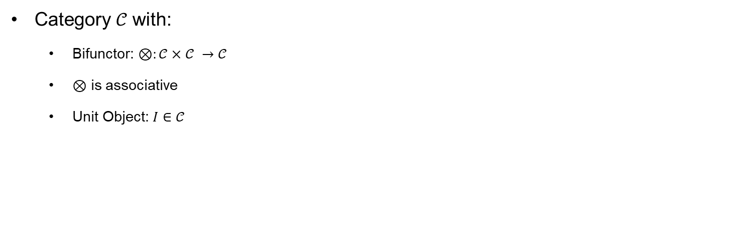
Monoidal Category
Category $𝒞$ with:
Bifunctor: $⊗:𝒞×𝒞 →𝒞$
$⊗$ is associative
Unit Object: $I∈𝒞$
IMG PAR With ID
$$f⊗g⊗h :A⊗B⊗C→B⊗C⊗D$$

Slide 13
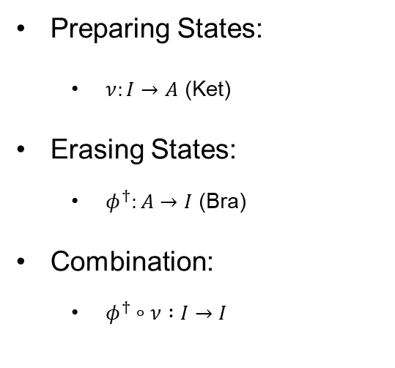
Monoidal Category
IMG Preparing / erasing
Preparing States:
$ν:I→A$ (Ket)
Erasing States:
$φ^{†}:A→I$ (Bra)
Combination:
$φ^{†}∘ν :I→I$

Slide 14
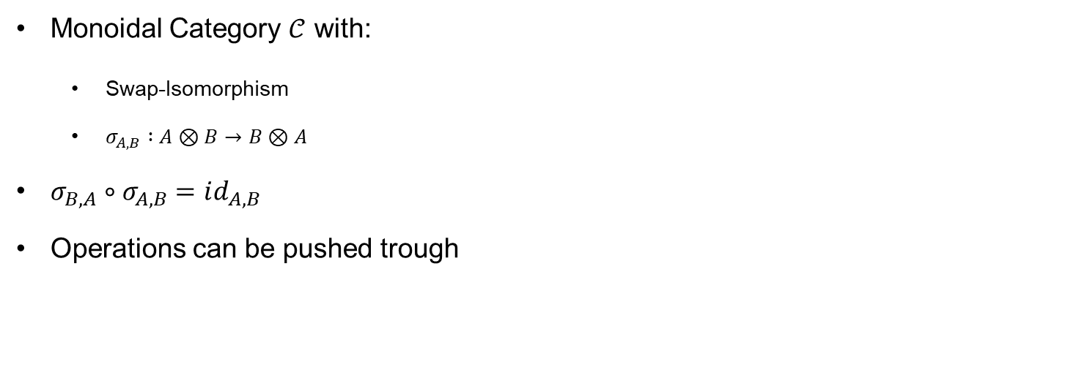
Symmetric Monoidal Category
Monoidal Category $𝒞$ with:
Swap-Isomorphism
$σ_{A,B} :A⊗B→B⊗A$
$σ_{B,A}∘σ_{A,B}=id_{A,B}$
Operations can be pushed trough
SWAP

Slide 15
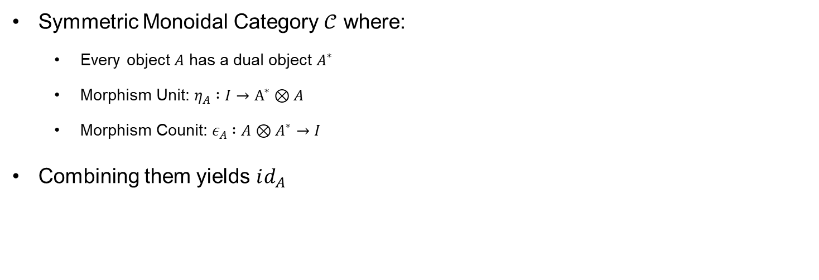
Compact Monoidal Category
Symmetric Monoidal Category $𝒞$ where:
Every object $A$ has a dual object $A^{∗}$
Morphism Unit: $η_{A} :I→A^{∗}⊗A$
Morphism Counit: $ε_{A} :A⊗A^{∗}→I$
Combining them yields $id_{A}$
CAP CUP

Slide 16
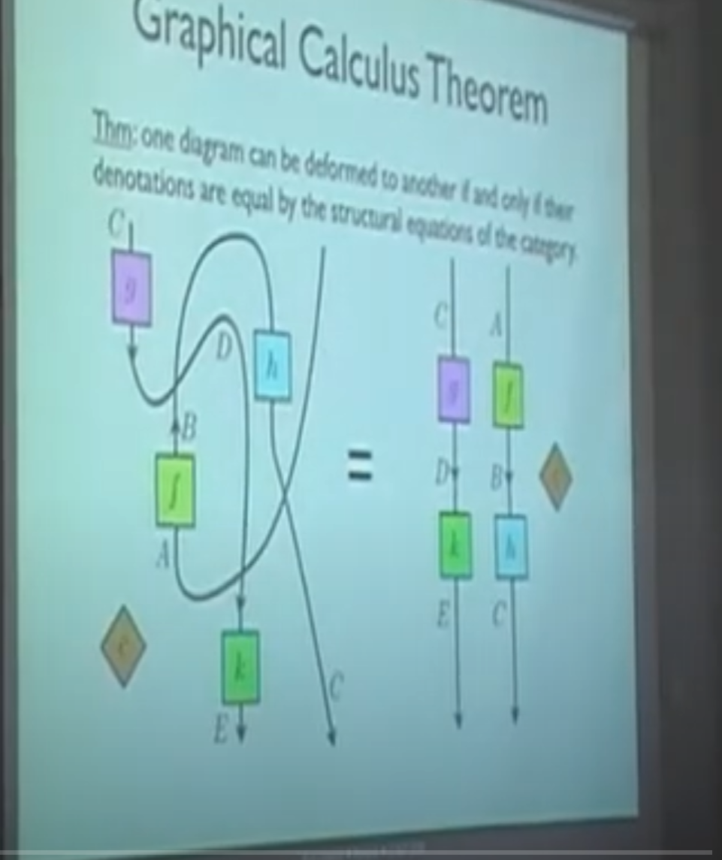
Graphical Calculus
Visually combine Elements of the Category
Process Theory
Main Idea of ZX-Calculus:
Represent Circuit as Network of Processes
Apply Simplifications on the Network
“Only topology Matters”
If it looks like the same graph its the same thing
Guaranteed by the rules of the Category

Slide 17
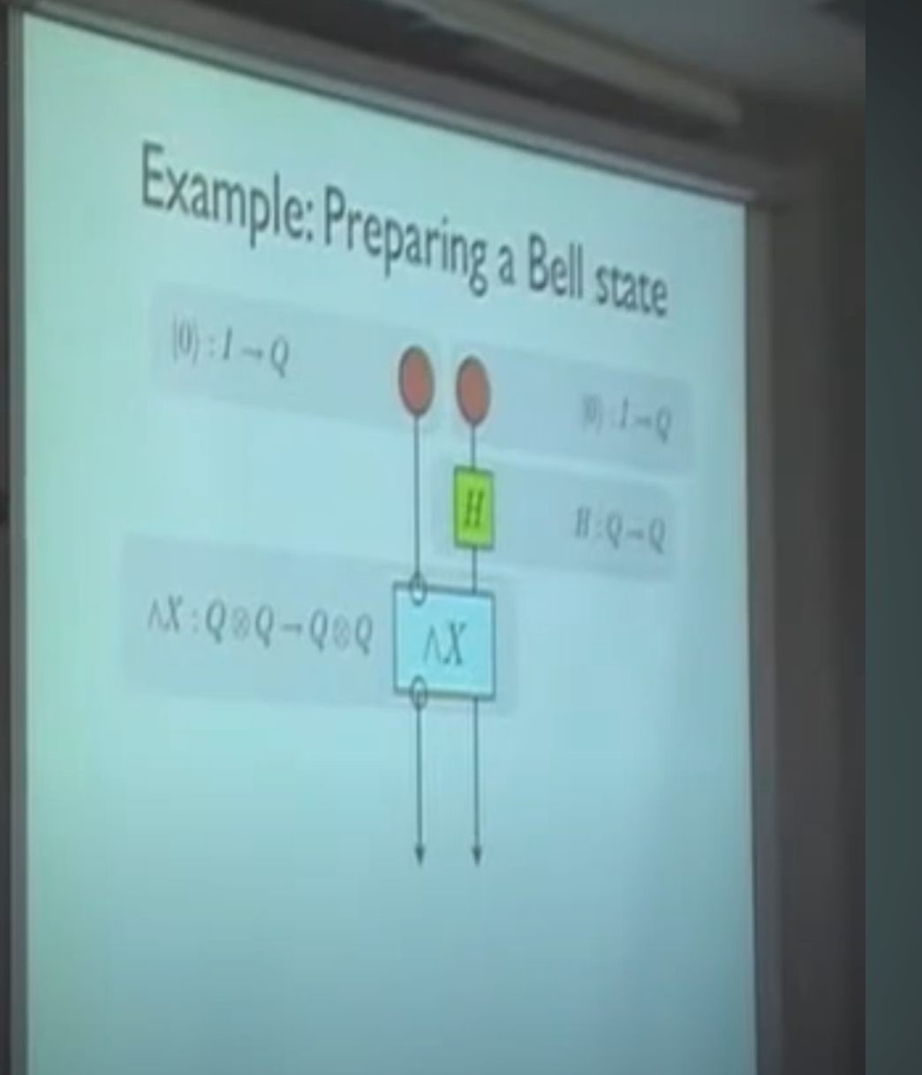
Example Network: CNOT
Prepare Qubits
Apply Hadamard
Apply CNTOT

Slide 18
Image Sources
Fig. 1: ZX-Circuit https://upload.wikimedia.org/wikipedia/commons/5/50/Zx-diagram-example.svg
Fig. 2: Circuit Identities https://www.cs.ox.ac.uk/people/aleks.kissinger/slides/qnlp-40mins.pdf
Fig. 3: Quantum Compilation https://www.researchgate.net/figure/Quantum-circuit-compilation-47_fig15_348930917
Fig. 4: Fault tolerant Toffoli Gate https://www.researchgate.net/figure/The-fault-tolerant-Clifford-T-implementations-of-quantum-logic-gates-used-in-this-work_fig1_322049116

